Slide 1
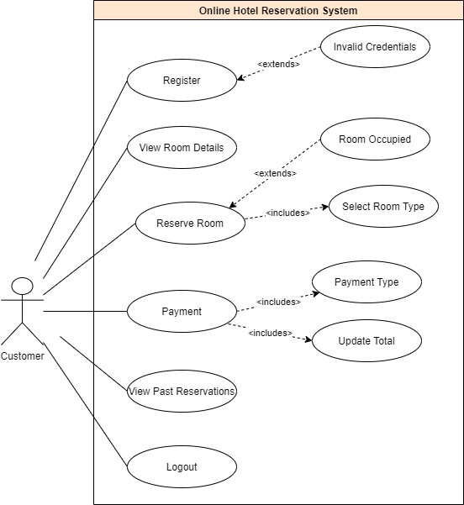
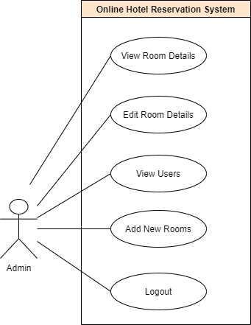
System description
1
Hotel Management System
Notes:
1

Slide 2
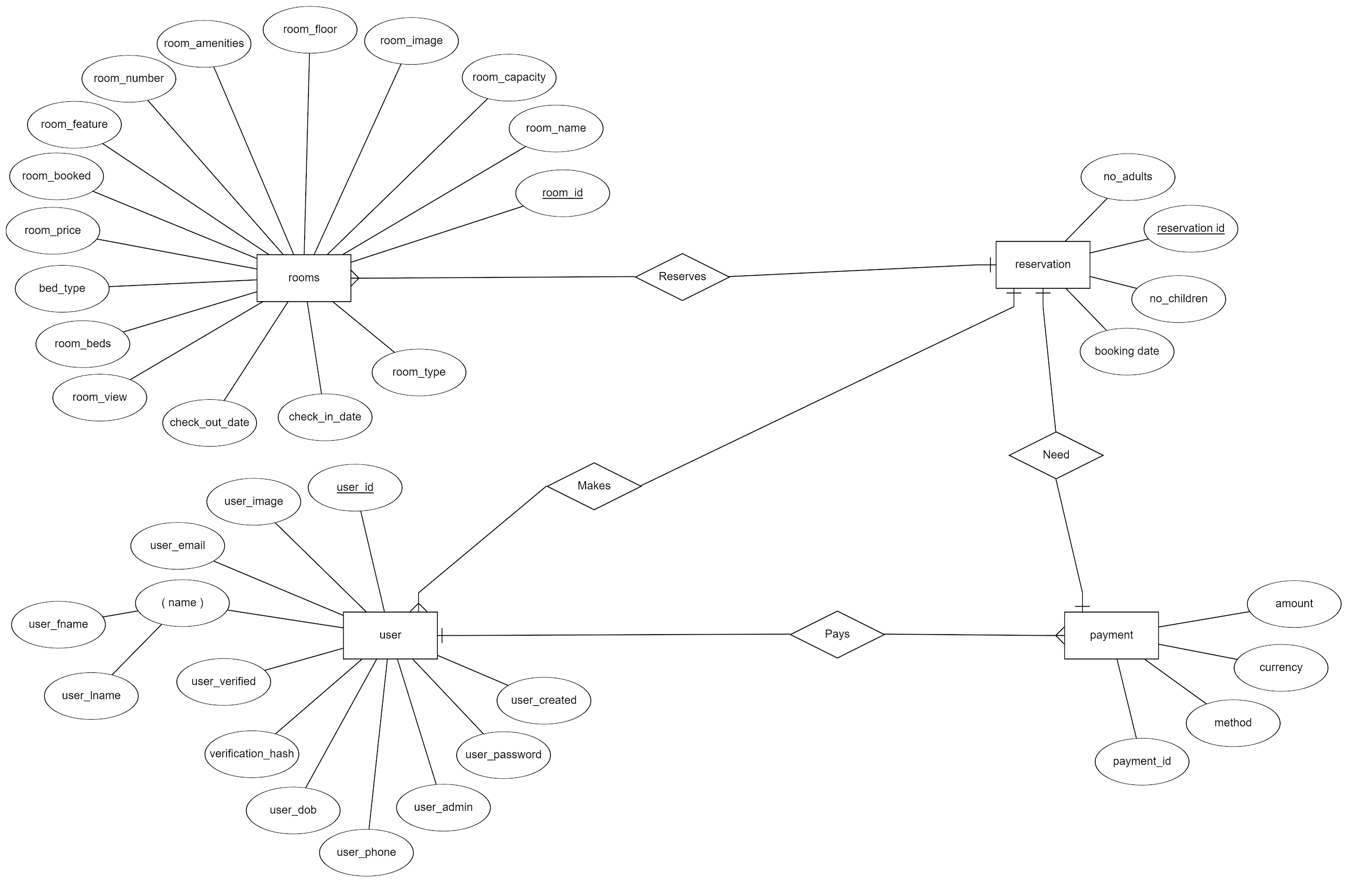
System description
2
Hotel Management System
Notes:
2

Slide 3
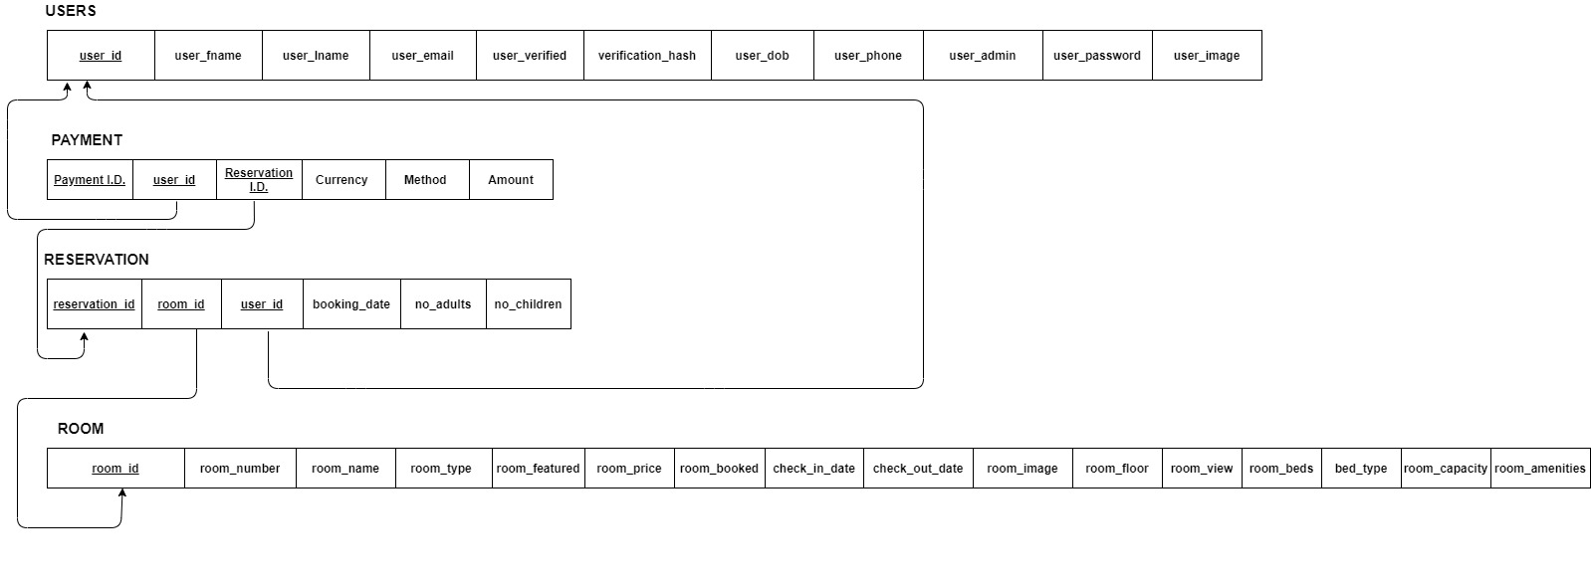
System description
3
Hotel Management System
Notes:
3

Slide 4
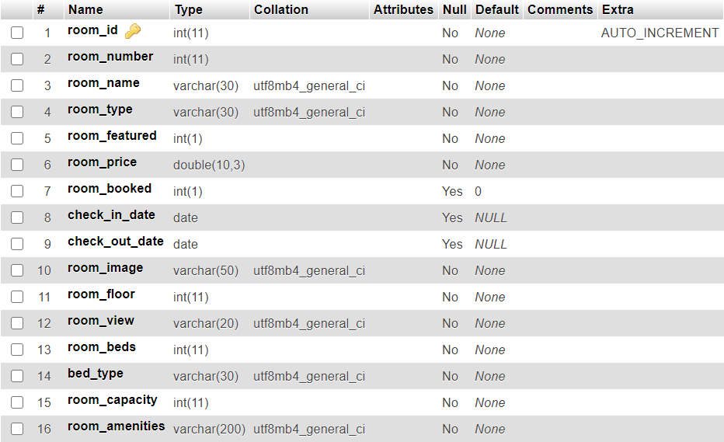
Database Tables
Room Table
4
Hotel Management System
Notes:
4

Slide 5
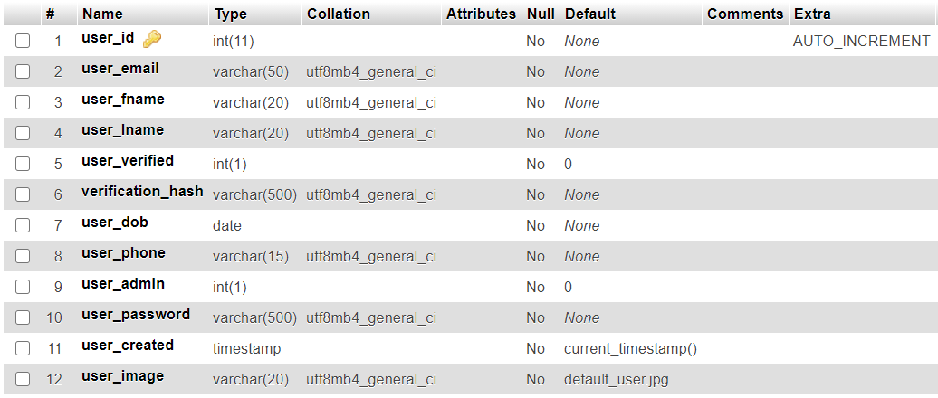
Database Tables
User Table
5
Hotel Management System
Notes:
5

Slide 6
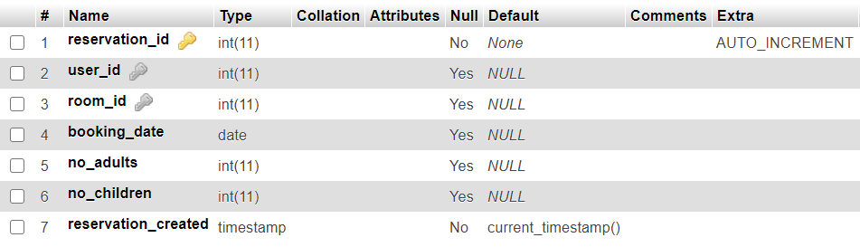
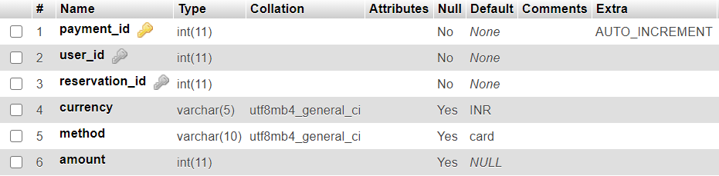
Database Tables
Reservation Table
Payments Table
6
Hotel Management System
Notes:
6

Slide 7
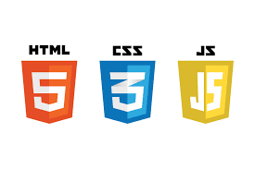



Hardware & software requirements
Software Requirements:
Development Tools:
Front End : HTML, CSS, JAVASCRIPT, JQUERY, BOOTSTRAP
Back End : PHP, MySQL
Operating System : Windows 10
Web server : XAMPP
Package Manager: Composer, NPM
Text Editor: VS Code
7
Hotel Management System
Notes:
7

Slide 8
Hardware & software requirements
Hardware Requirements
I/O devices
Monitor
Keyboard
Modern Computer with Modern Web Browser
Internet Connection
8
Hotel Management System
Notes:
8

Slide 9
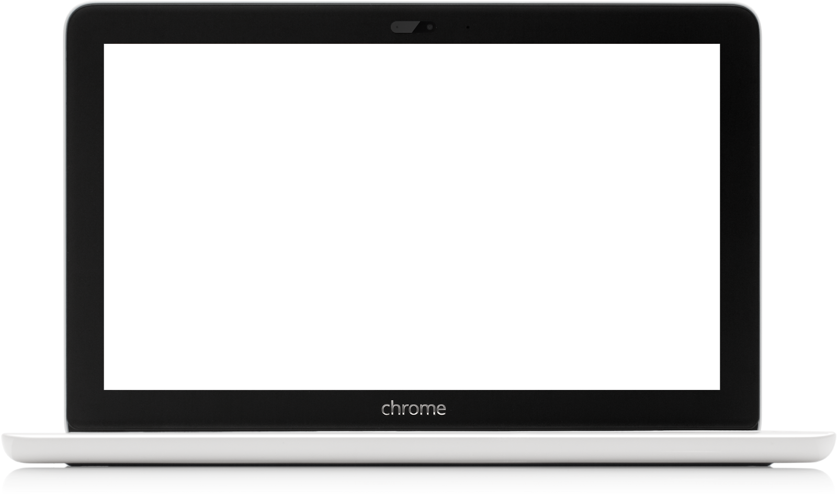
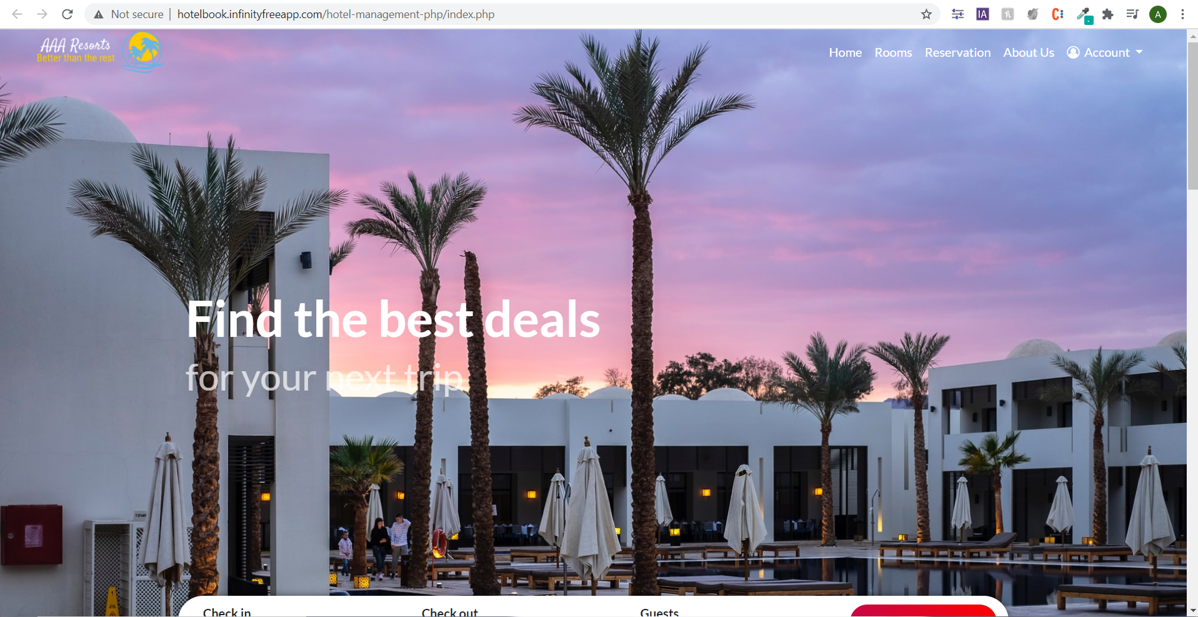

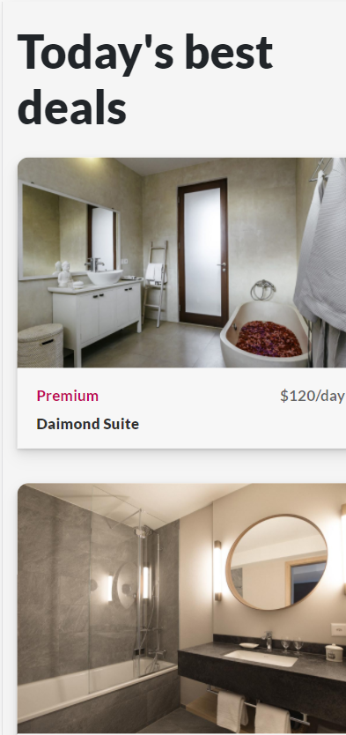
User Interface Design
Hotel Management System
9
Hotel Management System
Notes:
9

Slide 10
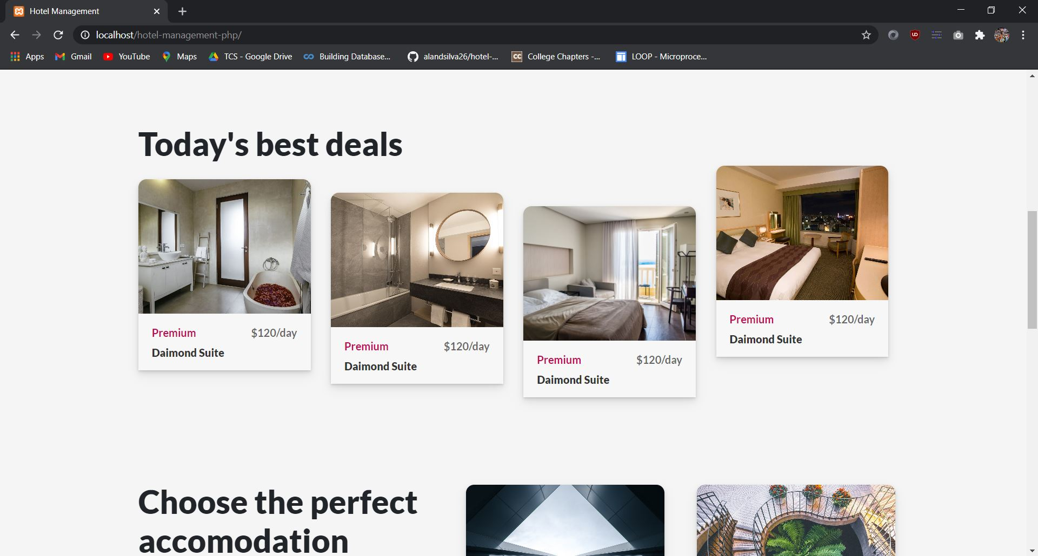
Homepage
10
Hotel Management System
Notes:
10

Slide 11
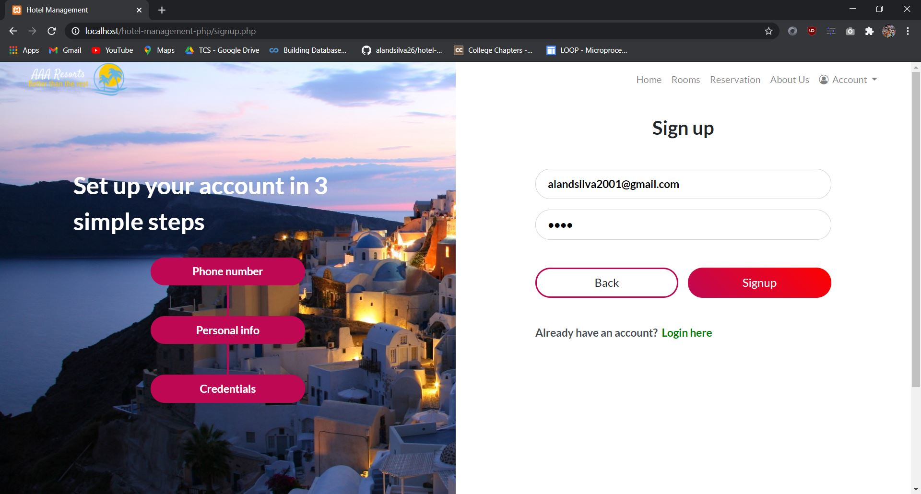
Sign Up
11
Hotel Management System
Notes:
11

Slide 12
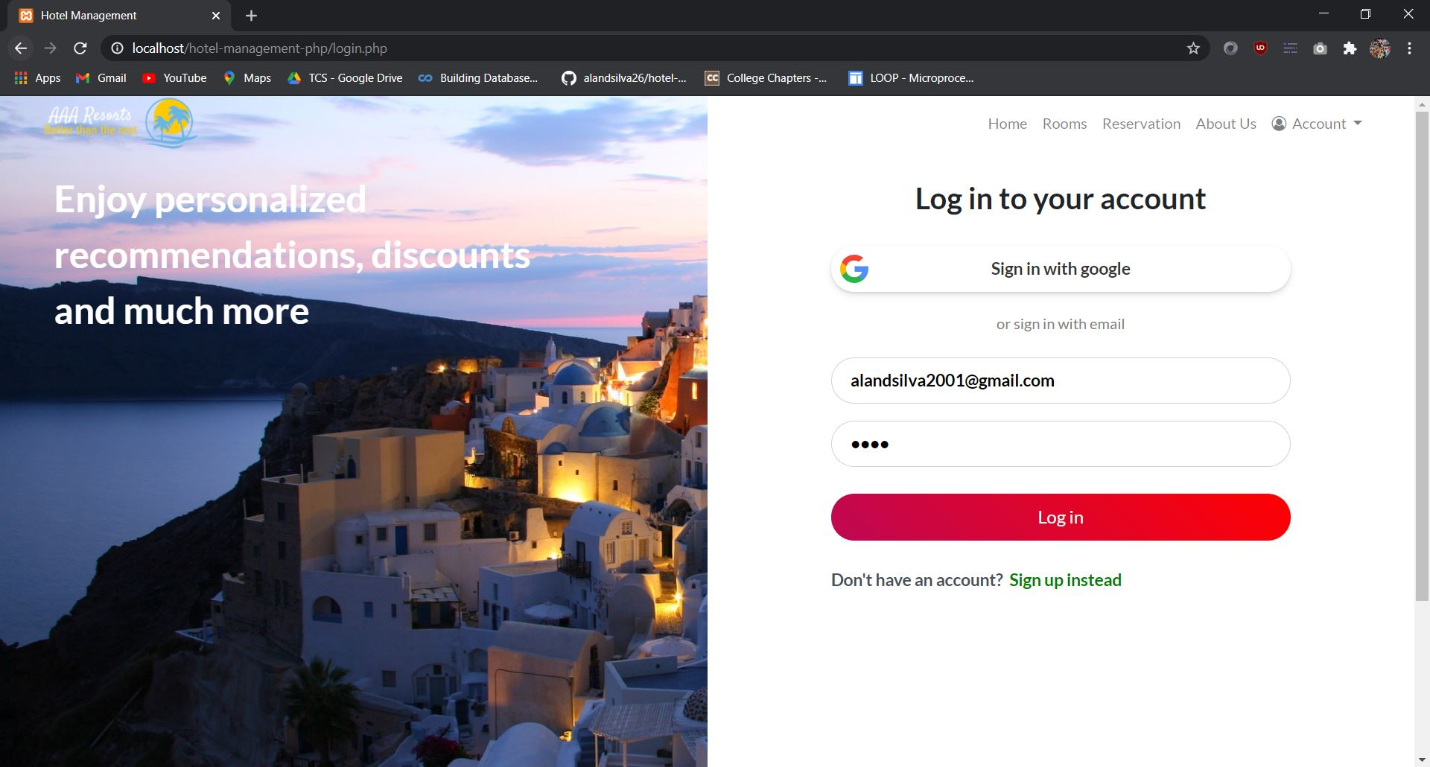
Login
12
Hotel Management System
Notes:
12

Slide 13
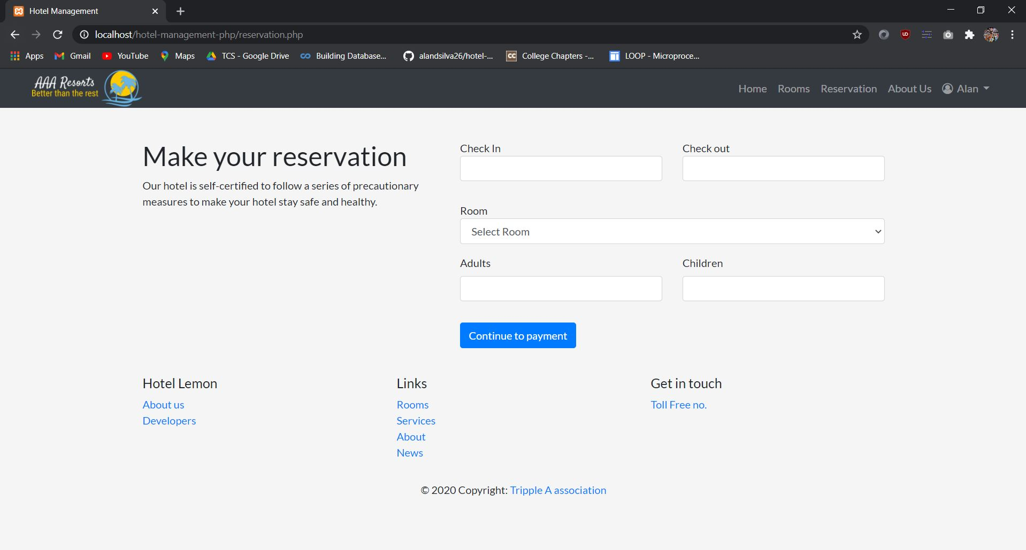
Reservation
13
Hotel Management System
Notes:
13

Slide 14
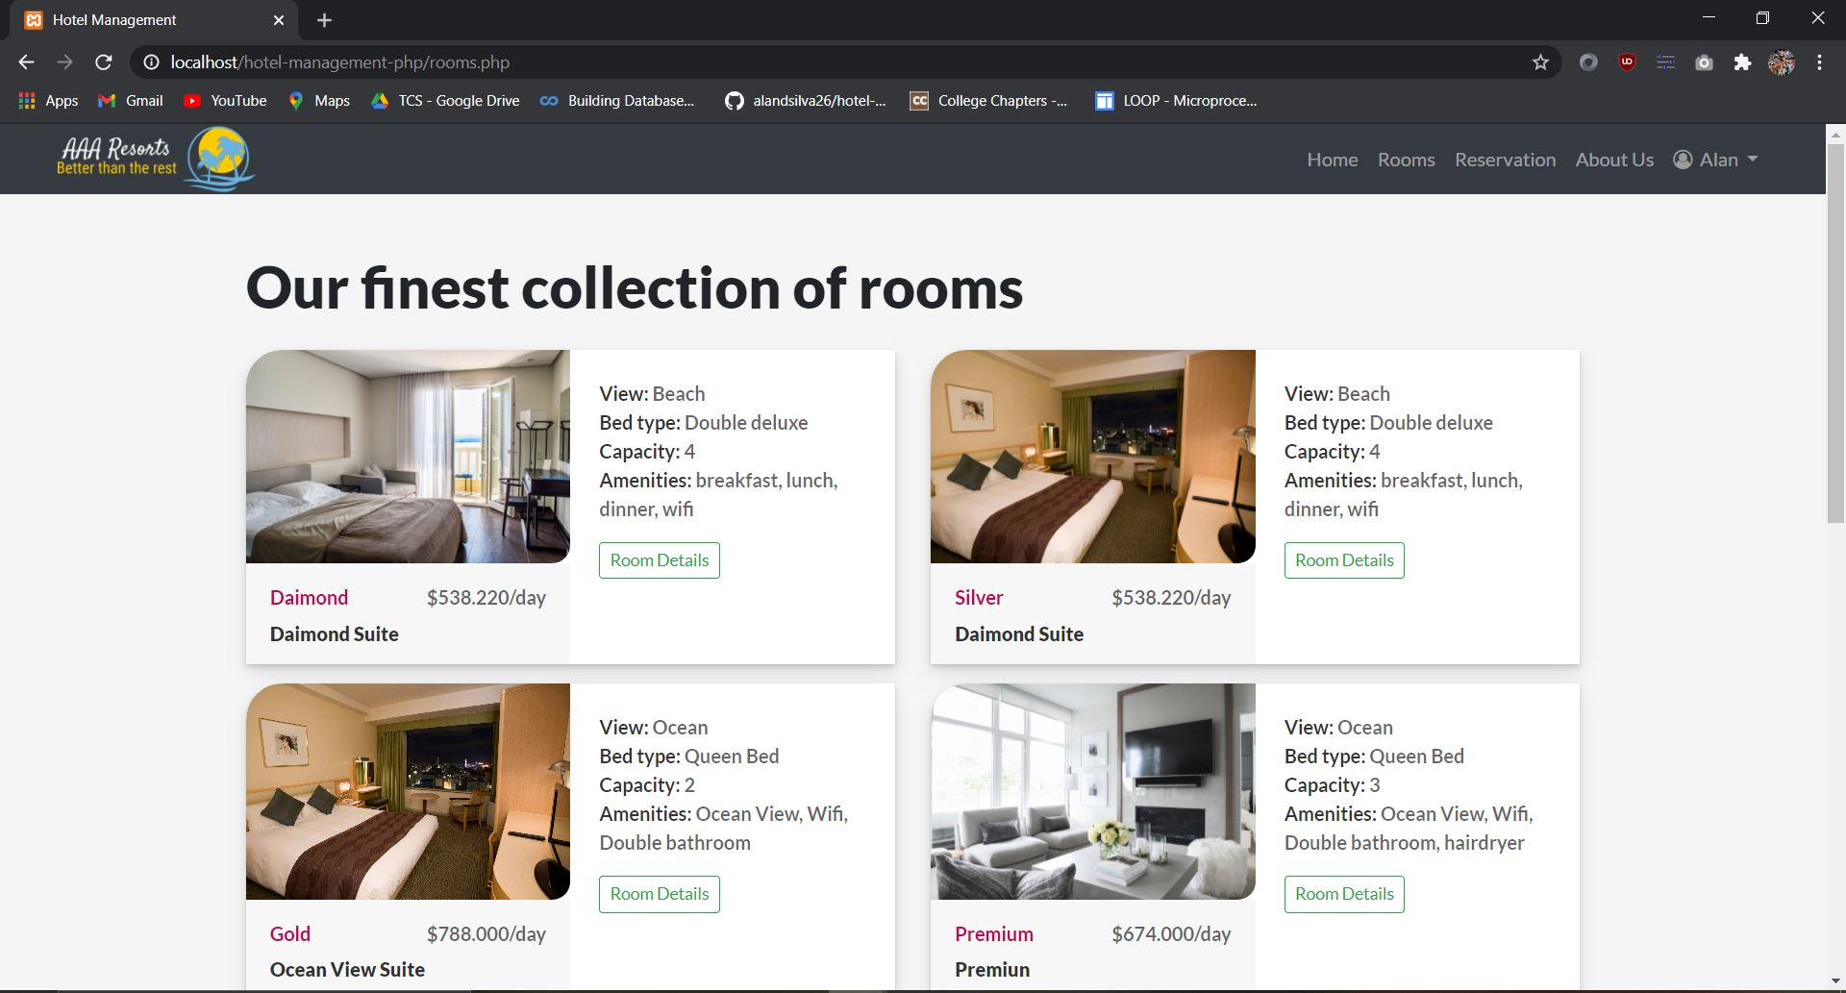
View Rooms
14
Hotel Management System
Notes:
14

Slide 15
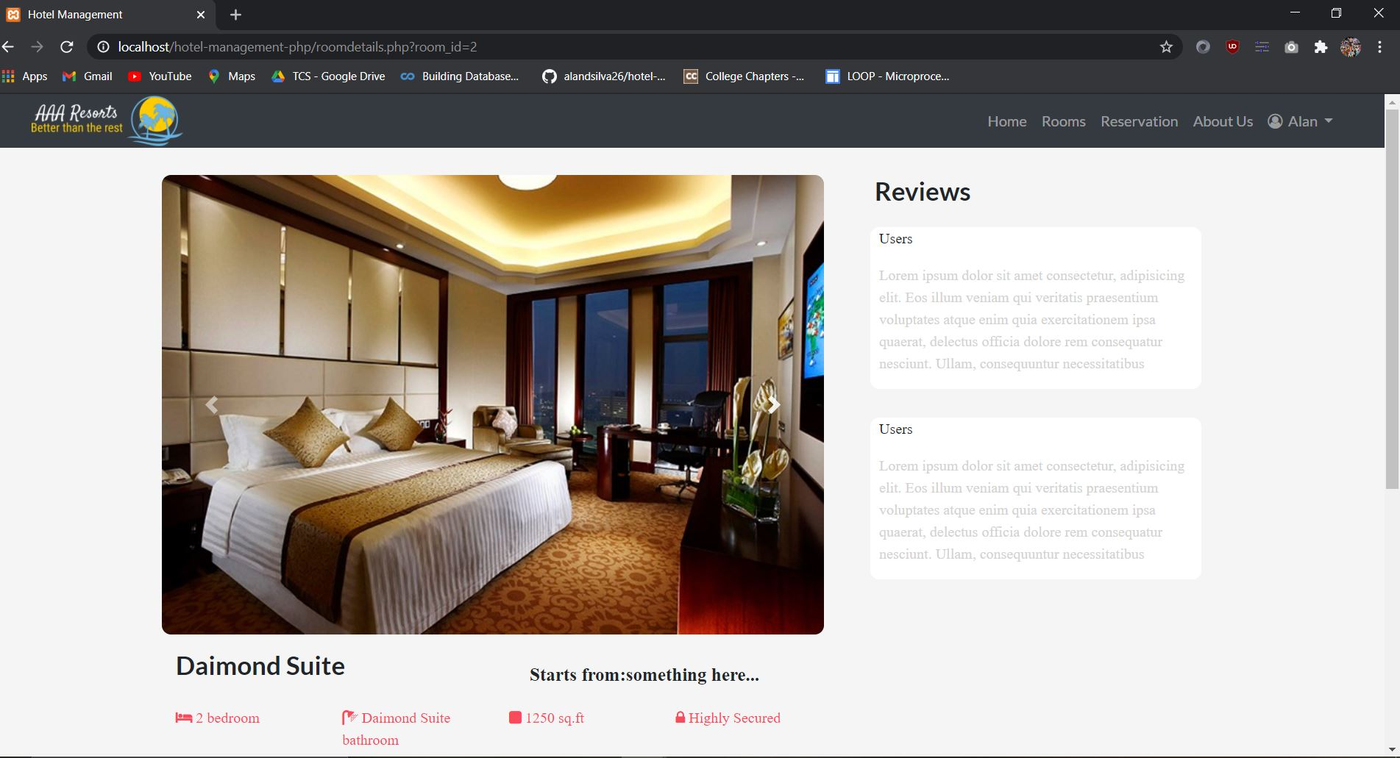
Room Details
15
Hotel Management System
Notes:
15

Slide 16
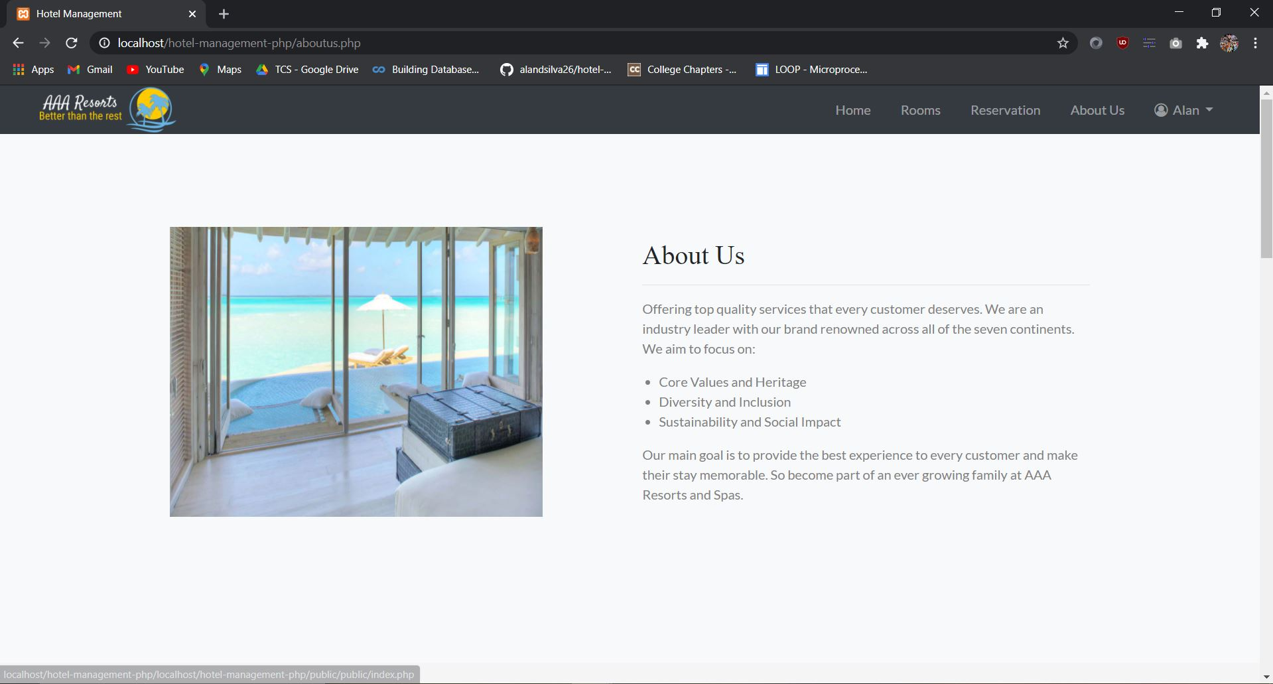
About Us
16
Hotel Management System
Notes:
16

Slide 17
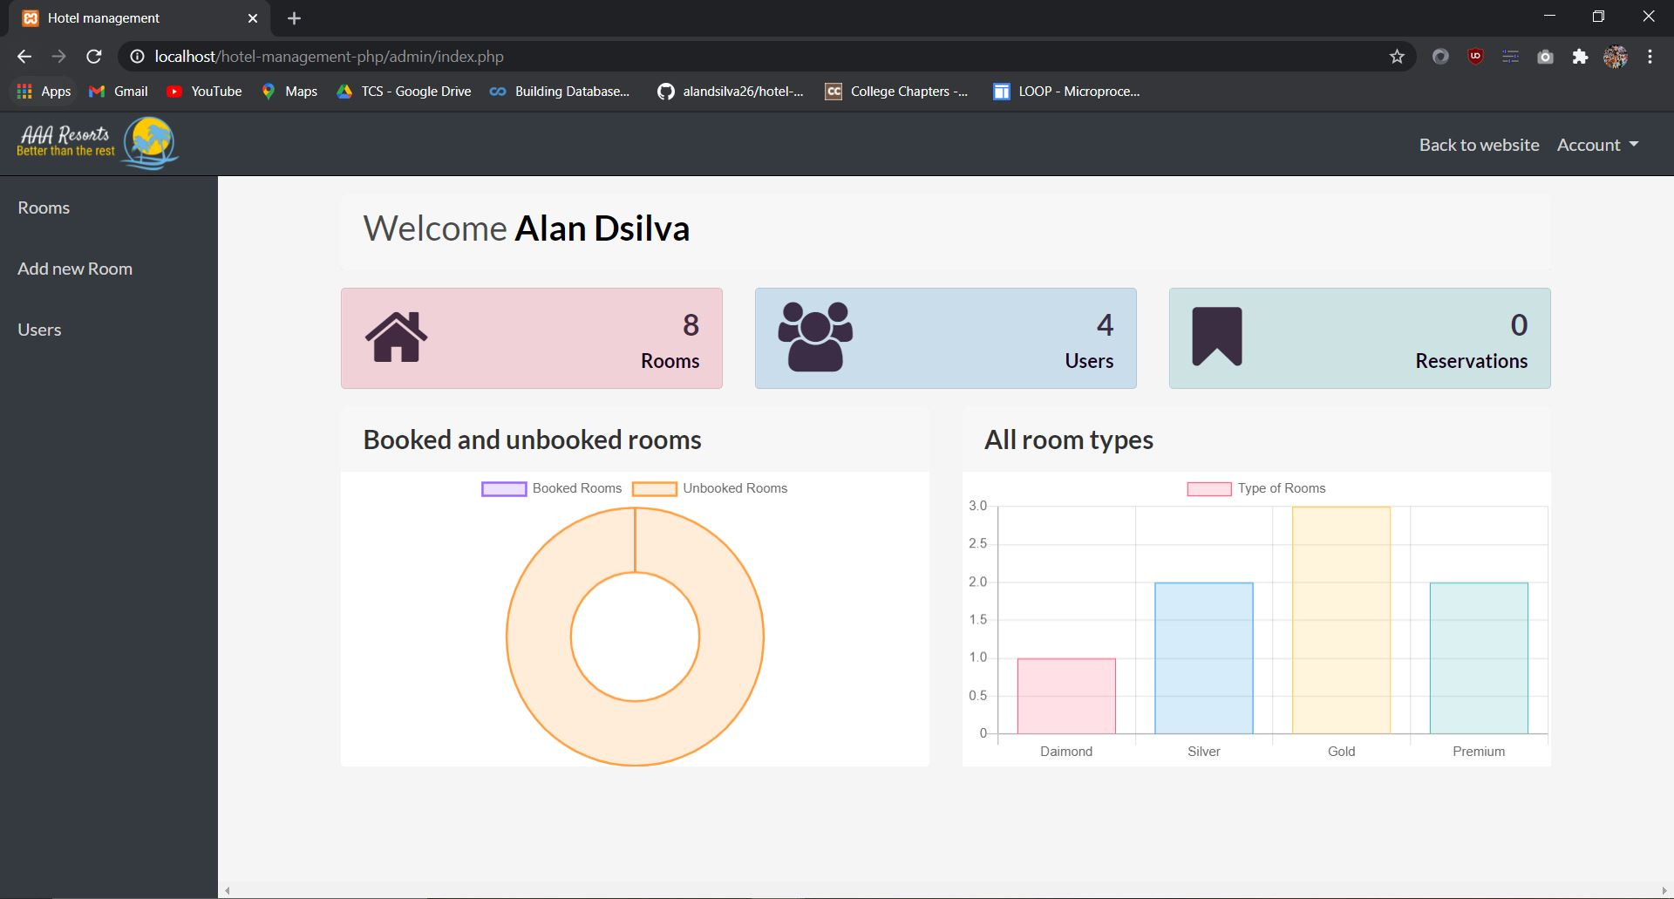
Admin Panel
17
Hotel Management System
Notes:
17

Slide 18
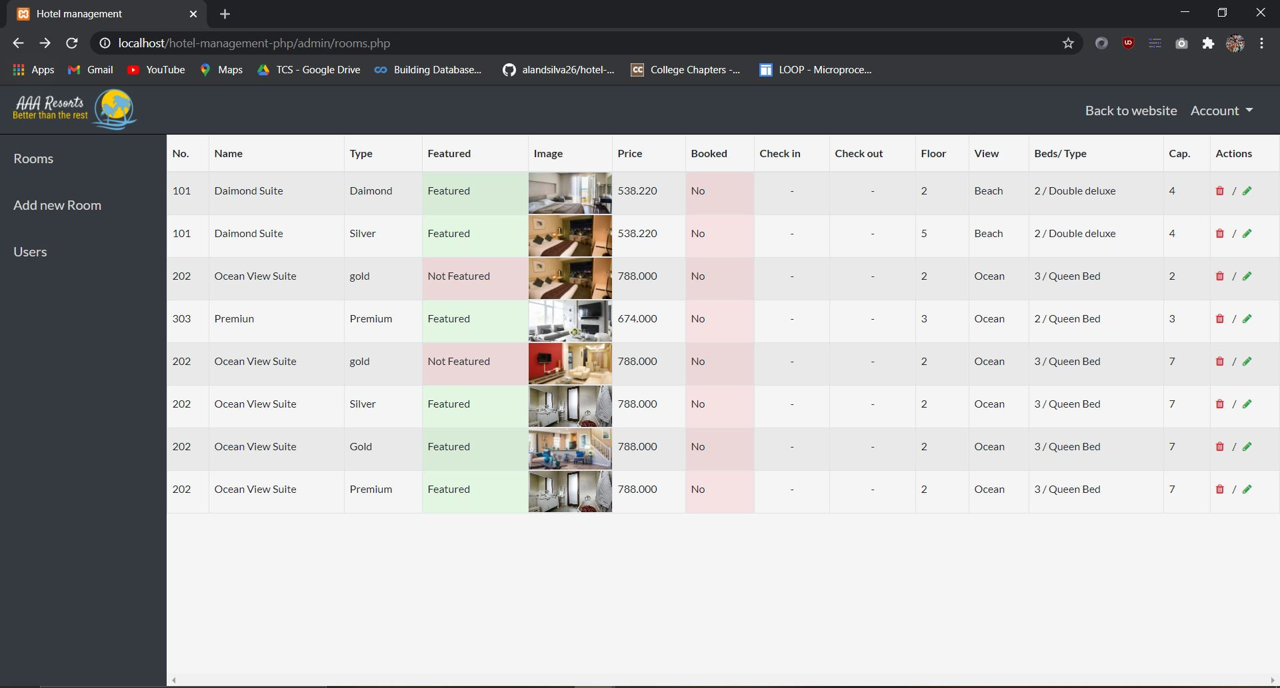
Admin Panel - Edit Rooms
18
Hotel Management System
Notes:
18

Slide 19
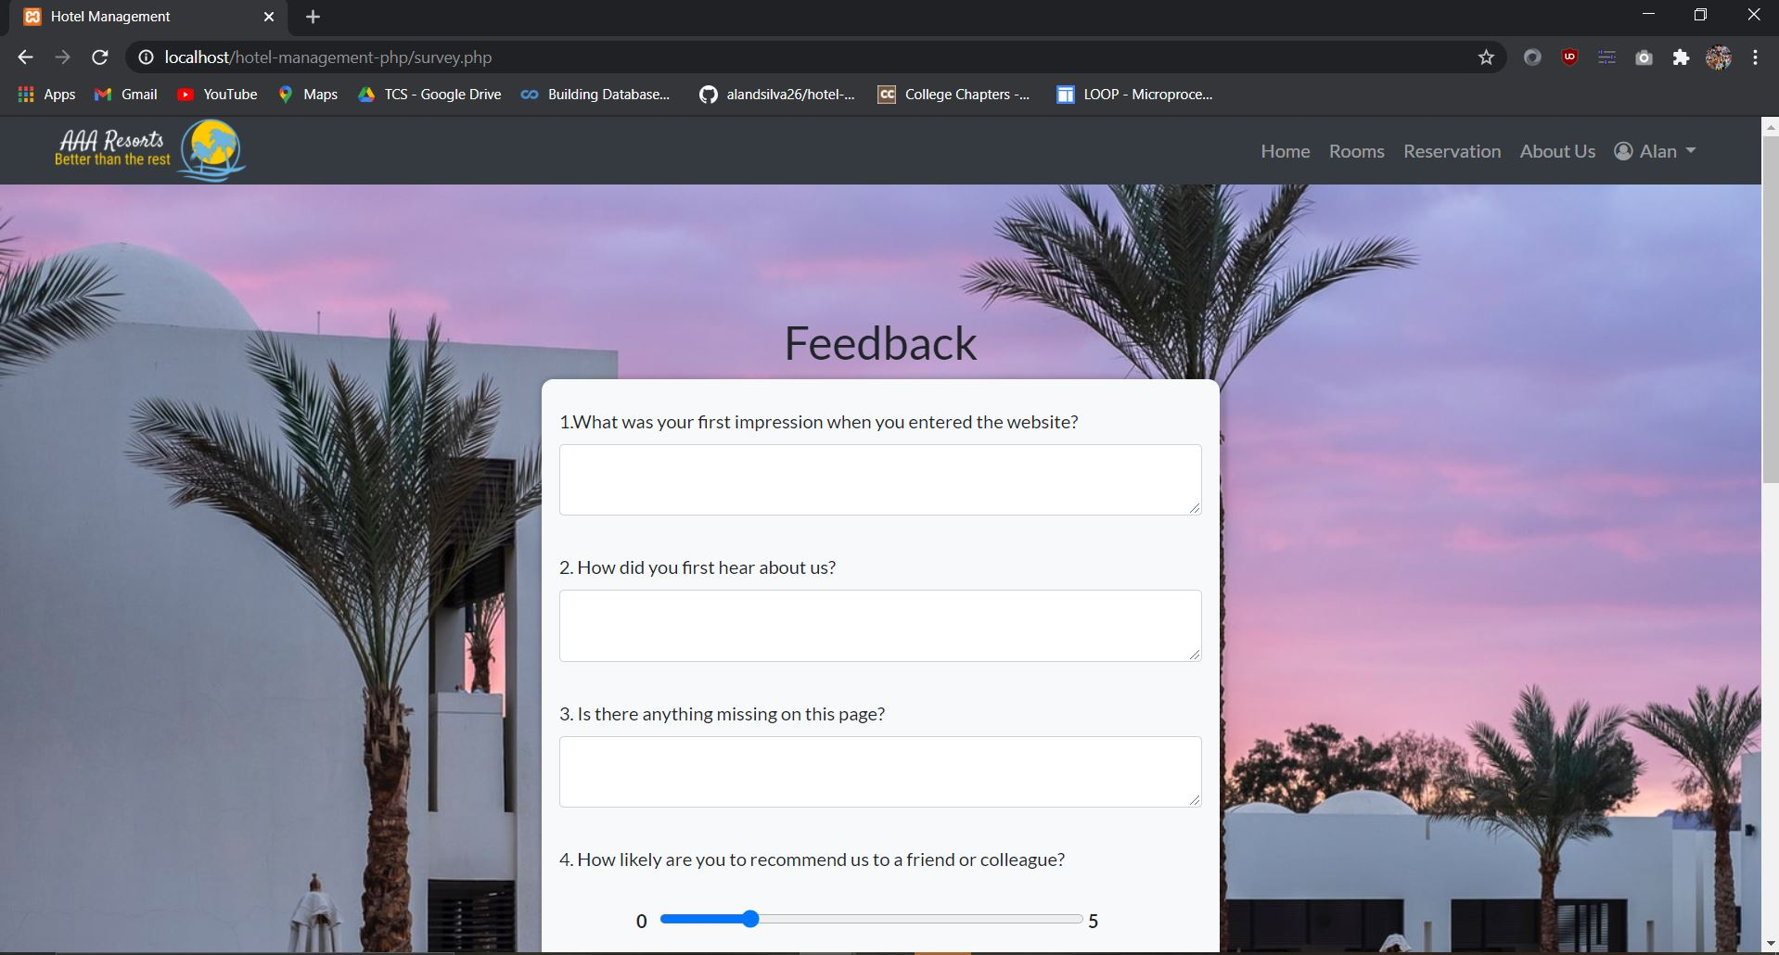
Feedback
19
Hotel Management System
Notes:
19

